Slide 1
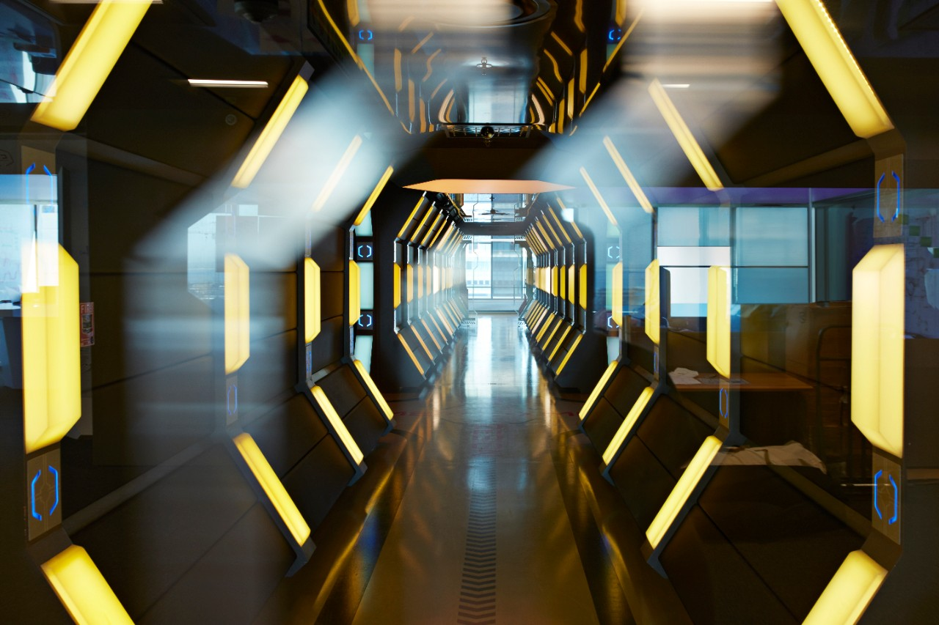

Succeeding in the disrupted world
Change as a new constant – how to compete and succeed in the ever changing markets
Agnieszka Gajewska
Sep 2022

Slide 2
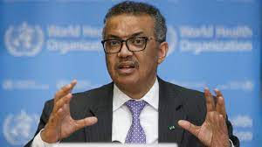
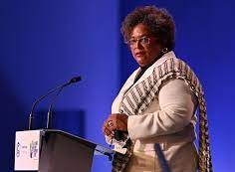
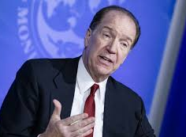
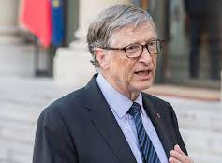
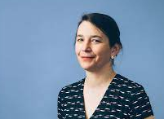
We started 2022 with some clear concerns
2022 must be the end of the COVID-19 pandemic. The longer inequity continues, the higher the risks of the virus evolving in ways we can’t prevent or predict.
The pandemic has taught us that national solutions to global problems do not work.
Tedros Adhanom Ghebreyesus
WHO Director General
Mia Amor Mottley
The Prime Minister of Barbados,
Challenging times lie ahead for the global economy - and particularly for developing countries - as economic stimulus slows and credit conditions tighten.
We need governments to take action if we’re going to make progress on challenges like avoiding a climate disaster or preventing the next pandemic. But declining trust makes it harder for them to be effective.
David Malpass,
World Bank Group President
Bill Gates
Next year’s news will be dominated by the impact of inflation caused by supply-chain bottlenecks, labor shortages, and high energy prices. Governments will wrestle with how to address these problems without exacerbating inequality or slowing the transition to renewables.
Brooke Masters,
Chief Business Commentator, Financial Times

Slide 3

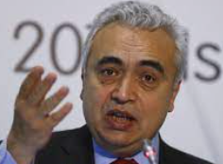
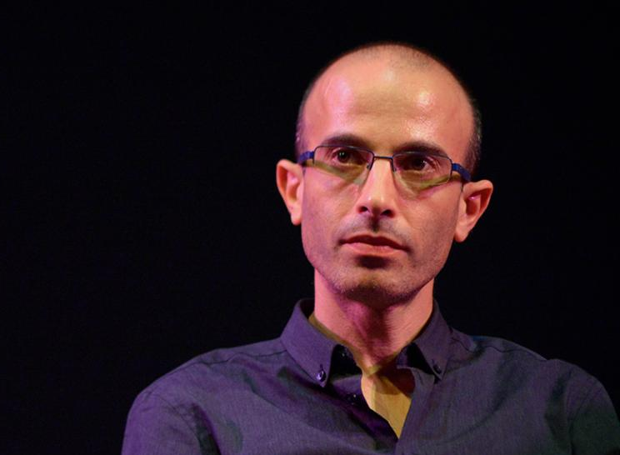
The war in Ukraine has added additional global challenges
World is facing the largest humanitarian crisis since World War II with approx. 6.5m people fled Ukraine.
UN Refugee Agency (UNHCR)
“Russia’s invasion of Ukraine has shaken the global energy system (...). At the same time, we cannot lose sight of the climate crisis that, left unchecked, will bring even greater disruption and suffering.”
Fatih Birol, Executive Director of the IEA
“If Putin wins in Ukraine, rulers all over the world will imitate him. (...) The money that should go to teachers, nurses and social workers would instead go to tanks, missiles and cyber weapons.”
Yuval Noah Harari

Slide 4
Serious crises are happening more frequently: we must solve for the short-term crises with the long-term trends in mind
Examples of short-term crises brought about by long-term trends
1
We must address the long-term trends in order to slow the pace at which short-term crises happen and their severity.
Inflation
Recession
Energy crisis
2
We must address the short-term crises in a way that makes the long-term crises better, or at least not worse.
War in Ukraine
Supply chain disruptions
COVID
Great resignation
PwC
4

Slide 5
Megatrends have significant social implications: Corporations, governments, and individuals all play a role in addressing these implications
A
Asymmetry: Increasing wealth disparity and erosion of the middle class
Climate
change
Technology
D
Disruption: Impact of technology, climate change, and significant events
A
Social
Age: Population shifts and demographic pressures
P
Polarisation: Breakdown in global consensus and a fracturing world, with growing nationalism and populism
Fracturing
world
Demography
T
Trust: Declining confidence in the institutions that underpin society

Slide 6
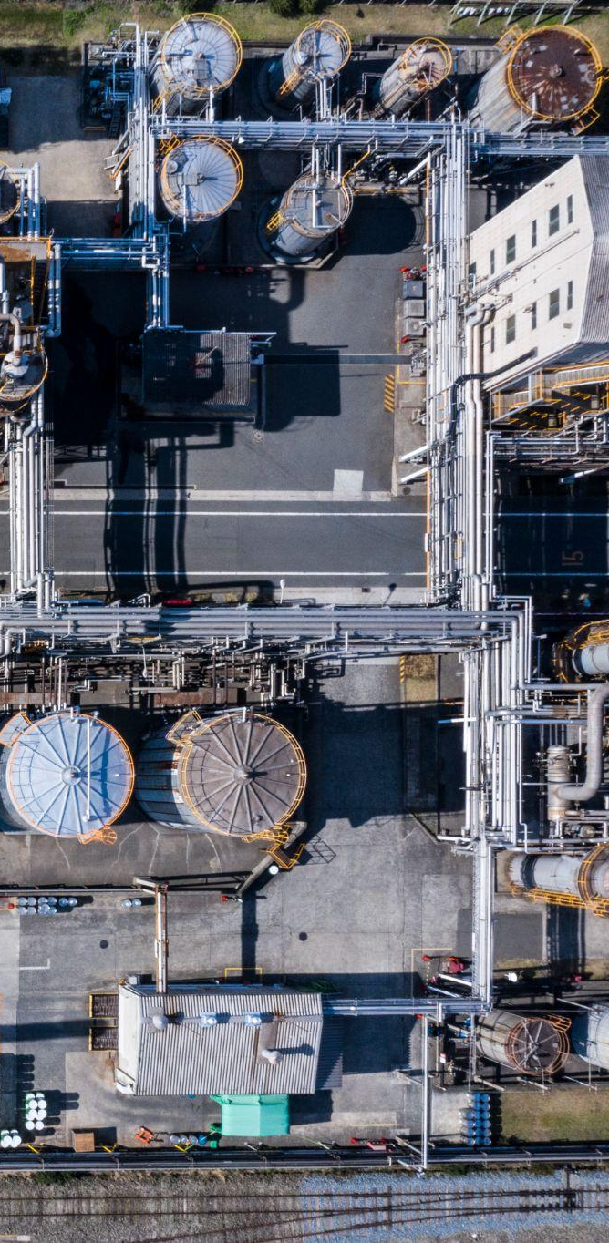
Real life example - Impact on Energy
Illustrative examples of ompact of the crisis
Government
Corporates
Investors
Consumers
Energy security more important
Optionality for some countries others less so
Adding pressure to prices (e.g. LNG flows)
Pathway to decarbonisation more complex
Affordability of energy transition compounding concerns around cost of living crisis for consumers
Potential food crisis another risk to manage
More pressure on government to play interventionist role
Inflationary pressure of commodities (Energy and non-Energy) feeding into supply chain leading to cost escalation
Limited measures to mitigate higher Energy costs. Cost reduction necessary elsewhere in business
Potential limited access to finance
Some Energy corporates will benefit (especially with trading capabilities)
Tightening monetary policy may reduce availability of international / national capital deployment
Some commodity traders facing liquidity issues raising concerns around banks’ exposure
Increased risk of default - negative impact of inflation and energy prices
Under pressure on multiple fronts form inflation (utility bills filling at the pump, food price escalation / scarcity)
Vulnerable populations in developing countries even more exposed to food insecurity and rising poverty
These factors will increase risk of political unrest in certain regions

Slide 7




So how to compete?
Embrace disruption
Build trust
Radical simplification
Long term goals
Reset your strategy
Re-prioritise and remodel
Employees - multiplier or detractor?
External stakeholders
Review your enablers
Embrace technology
Sustainability
Long terms needs
PwC

Slide 8
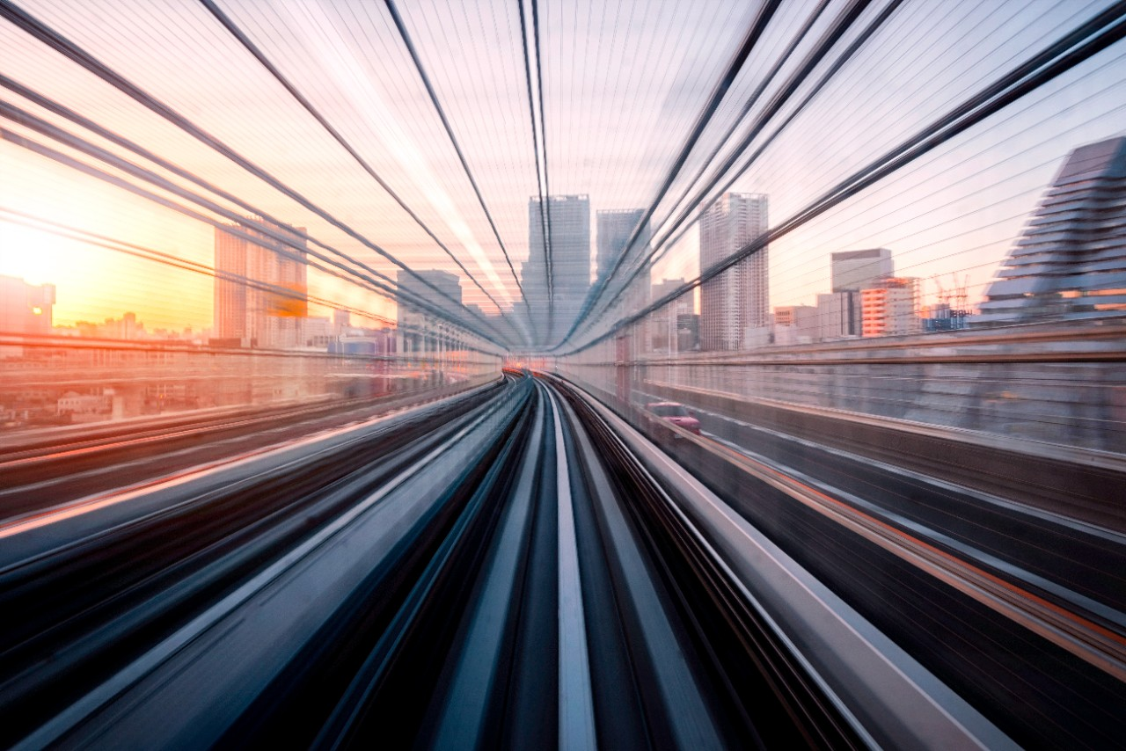
How to succeed?
Keep the momentum..
…and turn challenges into opportunities
PwC

Slide 9
Thank you
© 2022 PwC. All rights reserved. Not for further distribution without the permission of PwC. “PwC” refers to the network of member firms of PricewaterhouseCoopers International Limited (PwCIL), or, as the context requires, individual member firms of the PwC network. Each member firm is a separate legal entity and does not act as agent of PwCIL or any other member firm. PwCIL does not provide any services to clients. PwCIL is not responsible or liable for the acts or omissions of any of its member firms nor can it control the exercise of their professional judgment or bind them in any way. No member firm is responsible or liable for the acts or omissions of any other member firm nor can it control the exercise of another member firm’s professional judgment or bind another member firm or PwCIL in any way.

